Slide 1


FFTLasso: Large-Scale LASSO in the Fourier Domain
Adel Bibi, Hani Itani, Bernard Ghanem
Notes:
Hello all,
Thank you for coming. This is me Adel Bibi, and this is a joint work with Hani Itani supervised by Dr. Bernard Ghanem from KAUST. The paper title is “FFTLasso: Large –Scale LASSO in the Fourier Domain”.

Slide 2
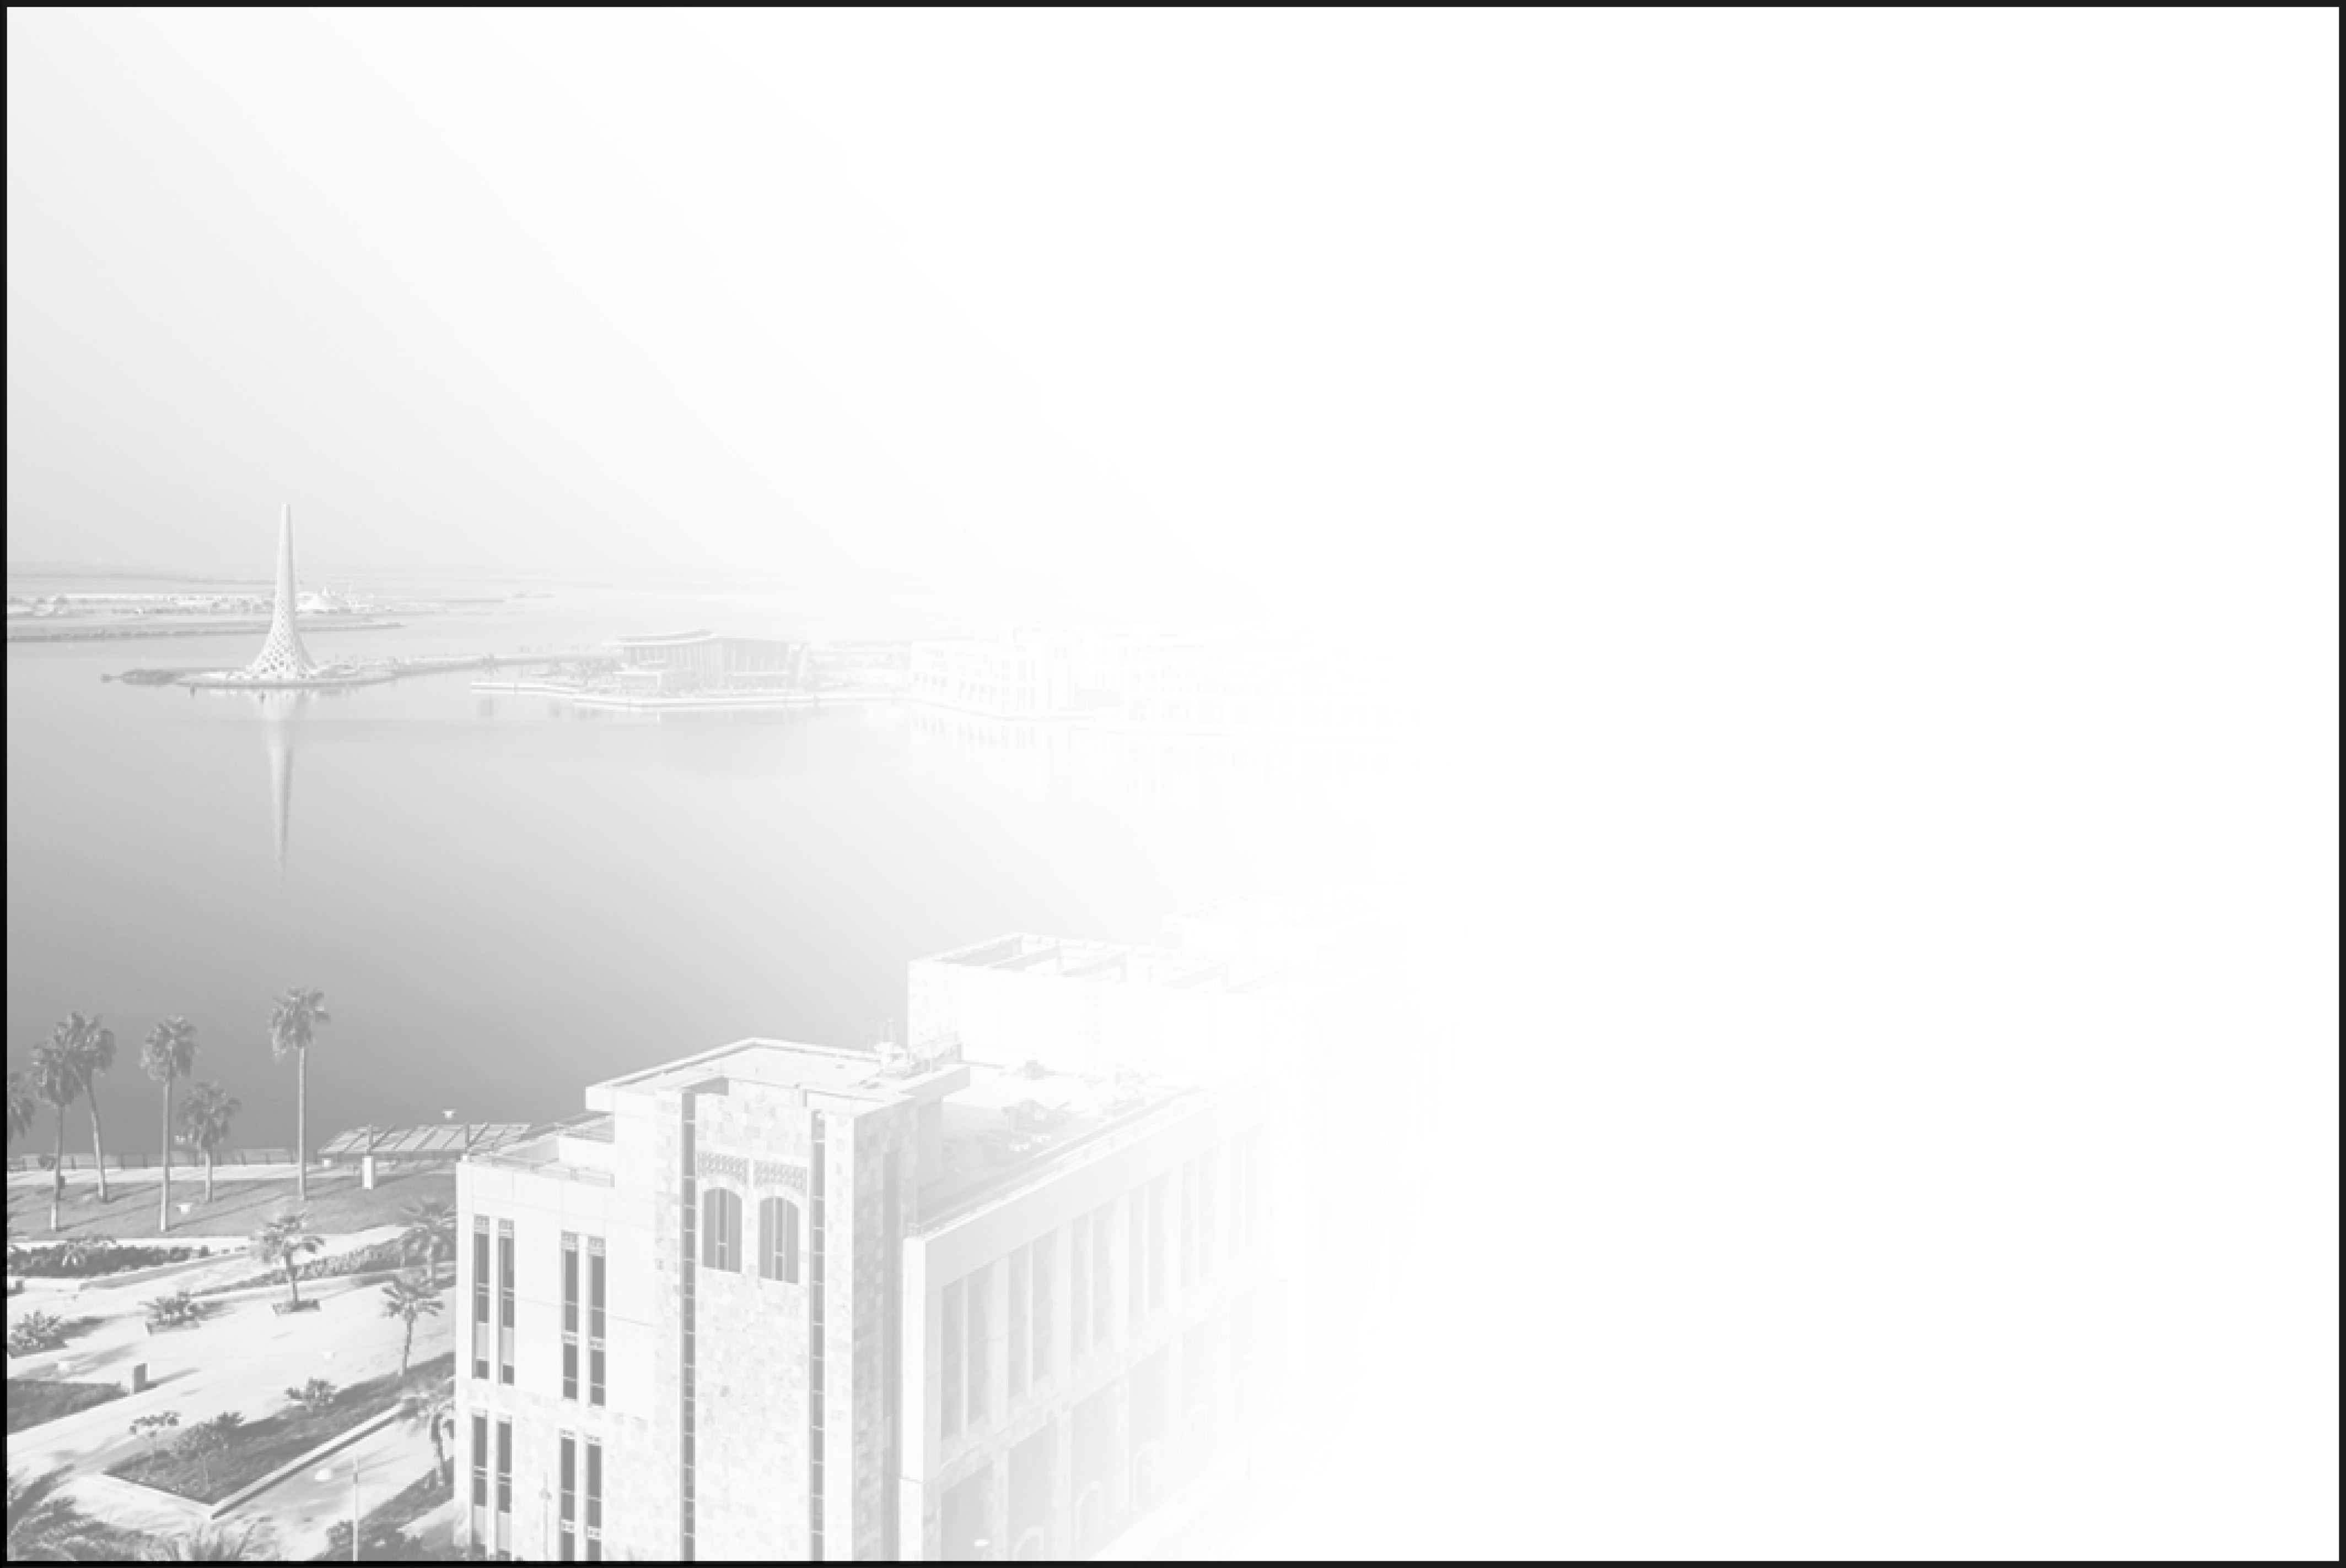
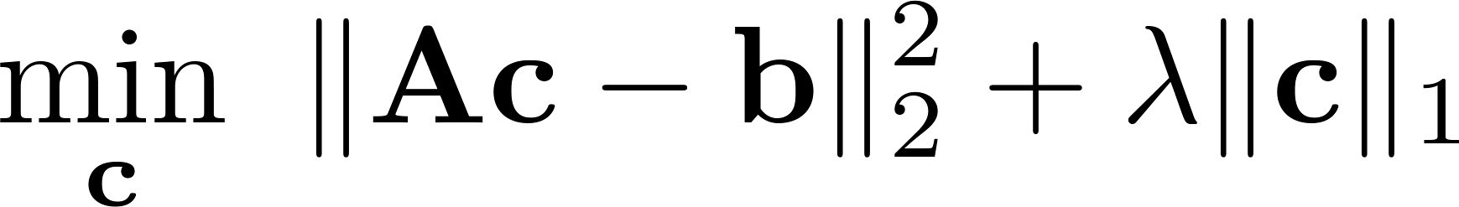
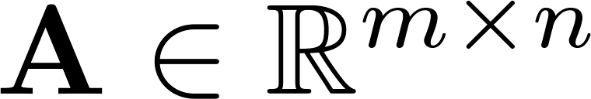
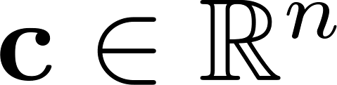
The LASSO
The LASSO is convex but not smooth
The matrix is often fat and denoted as the dictionary
is the sparse code
Many applications
Notes:
I’ll start off with the boring stuff. I have to introduce to you the LASSO and how is it important in computer vision.
So the LASSO is this optimization problem where we seek a solution vector c that fits the data with an L1 prior that induces sparsity. That is we seek to find the sparsest solution that best explains the data.
The problem in hand is convex; however, it is not smooth. We will denote the matrix A (which is often fat) as the dictionary and the solution c as the sparse code throughout the presentation.

Slide 3
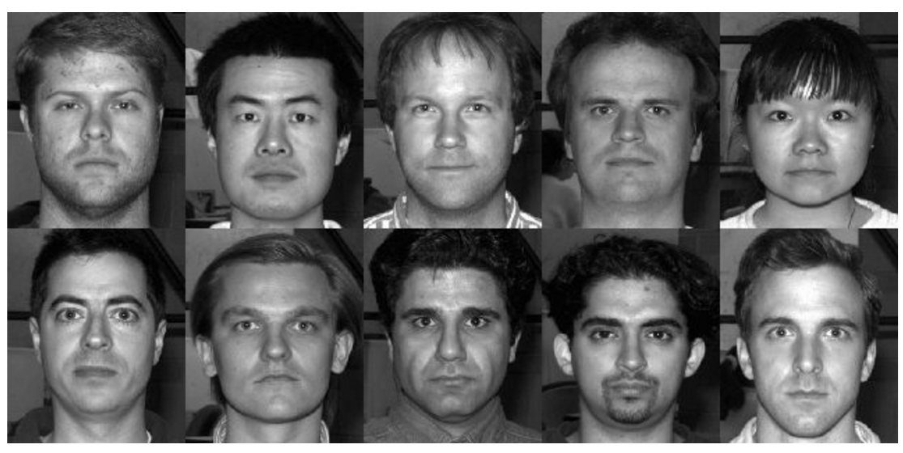

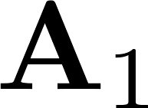
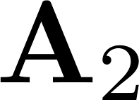
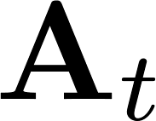



Applications of LASSO
Face Recognition
different people
Notes:
As for applications and where large scaleness come into play. Let’s examine the classical face recognition as an application.
As for face recognition for instance, the dictionary matrix A is composed here of several blocks. Each block represents a concatenation of say vectorized image patches of a given person in different say lightening conditions.
So if we have c blocks, we have c different people to recognize among. So, given a new test sample b that we require to determine to what person it belongs to, we look at the solution c and check where most of its coefficients are condensed.
So you can see now where large scaleness come into play. As for the columns, the more sets of categories of people we wish to classify the more columns we have. As for the number of rows, well it is a vectorized image which is self-explanatory. Either way, the dictionary A is large in at least one of the two dimensions.

Slide 4
Solving the LASSO
Pros: Inexpensive iteration cost
Cons: Lower convergence rate
Examples
(1) Proximal point methods
(2) ADMMs
Deterministic LASSO Solvers
First Order Methods
Second Order Methods
Pros: Quadratic convergence rates
Cons: Expensive Iteration cost
Examples
Primal dual interior point methods
Notes:
As for the solvers, LASSO solvers can in general be divided into randomized methods and deterministic methods. Randomized methods have demonstrated a great potential to solve linear systems very efficiently lately. However, this talk will be focused on deterministic solvers only.
First order deterministic methods enjoy inexpensive iteration cost with at most linear convergence rates. Proximal point methods and ADMMs are good examples.
Second order methods on the other hand require to have access to the hessian or at least a proxy version of it increasing their iteration computational complexity. They however enjoy quadratic rates. Proximal dual interior point methods are an example.

Slide 5
Solving the LASSO
The Focus of this work is on Deterministic First Order Methods
Pros: Inexpensive iteration cost
Cons: Lower convergence rate
Examples
(1) Proximal point methods
(2) ADMMs
Deterministic LASSO Solvers
First Order Methods
Second Order Methods
Pros: Quadratic convergence rates
Cons: Expensive Iteration cost
Examples
Primal dual interior point methods
Notes:
As for the solvers, LASSO solvers can in general be divided into randomized methods and deterministic methods. Randomized methods have demonstrated a great potential to solve linear systems very efficiently lately. However, this talk will be focused on deterministic solvers only.
First order deterministic methods enjoy inexpensive iteration cost with at most linear convergence rates. Proximal point methods and ADMMs are good examples.
Second order methods on the other hand require to have access to the hessian or at least a proxy version of it increasing their iteration computational complexity. They however enjoy quadratic rates. Proximal dual interior point methods are an example.

Slide 6
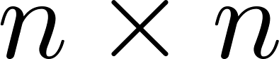
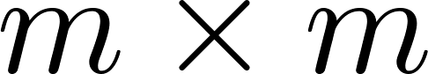
ADMM
ADMM
Primal Lasso (PL-ADMM)
Dual Lasso (DL-ADMM)
Solving a PD linear system
of size
Solving a PD linear system
of size
Notes:
Another approach is to use ADMM on either the Lasso directly given here as PL-ADMM. Or to lasso’s dual problem called here DL-ADMM.
The bottleneck really in either method boils down to solving linear systems. However, in general for primal lassos we need to solve a linear system of size nxn where for dual lasso it is of size mxm where A is of size mxn. Well, given that in the lasso often has a fat dictionary A (more columns than rows) the obvious answer DL-ADMM is significantly less expensive.

Slide 7
DL-ADMM
Pros:
Empirically shown to be one of the fastest first order deterministic LASSO solver
Handles Linear Constraints
Notes:
In fact it has been shown in many previous works that DL-ADMM is one of the best first order deterministic solver to use among all previous first order methods. It enjoys very good both theoretical and practical performance.

Slide 8
DL-ADMM
Pros:
Empirically shown to be one of the fastest first order deterministic LASSO solver
Handles Linear Constraints
Cons:
Requires linear system solver routine
Not trivially parallelized over many GPUs
Scalability issues
Notes:
In fact it has been shown in many previous works that DL-ADMM is one of the best first order deterministic solver to use among all previous first order methods. It enjoys very good both theoretical and practical performance.

Slide 9
New Solver?
The solver we seek should enjoy:
Low iteration complexity
ADMM’s linear convergence rate
Trivially distributed over multiple GPUs
Notes:
So what we really need is a solver that has a low iteration cost, enjoys ADMMs’ linear rates and most importantly has the ability to scale very well in a distributed fashion over multiple GPUs.

Slide 10
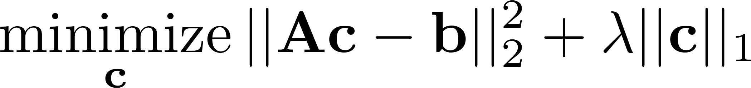

Problem Lifting
LASSO
1
5
i
j
x
2
2
6
k
y
3
7
l
z
.
2
m
f
4
8
.
Notes:
So the question that we asked ourselves is, do we benefit from lifting the lasso into a higher dimension and equip the space of that new dimension with some structure?

Slide 11


Problem Lifting
Problem lifting
LASSO
i
1
5
i
i2
j
x
2
1
4
3
2
5
8
7
6
i3
2
6
k
y
i4
x
2
2
1
3
6
5
8
7
l
4
y
3
7
.
z
j
z
2
4
6
5
8
m
f
3
2
1
7
j2
4
8
.
j3
f
2
4
3
2
1
8
7
6
5
.
j4
Notes:
Well, that’s exactly what we did. We generate even a bigger problem by transforming each column in the original matrix A into a circulant matrix as shown here. So if the original A is of size mxn, the new dictionary A tilde is of size m x (mn).

Slide 12
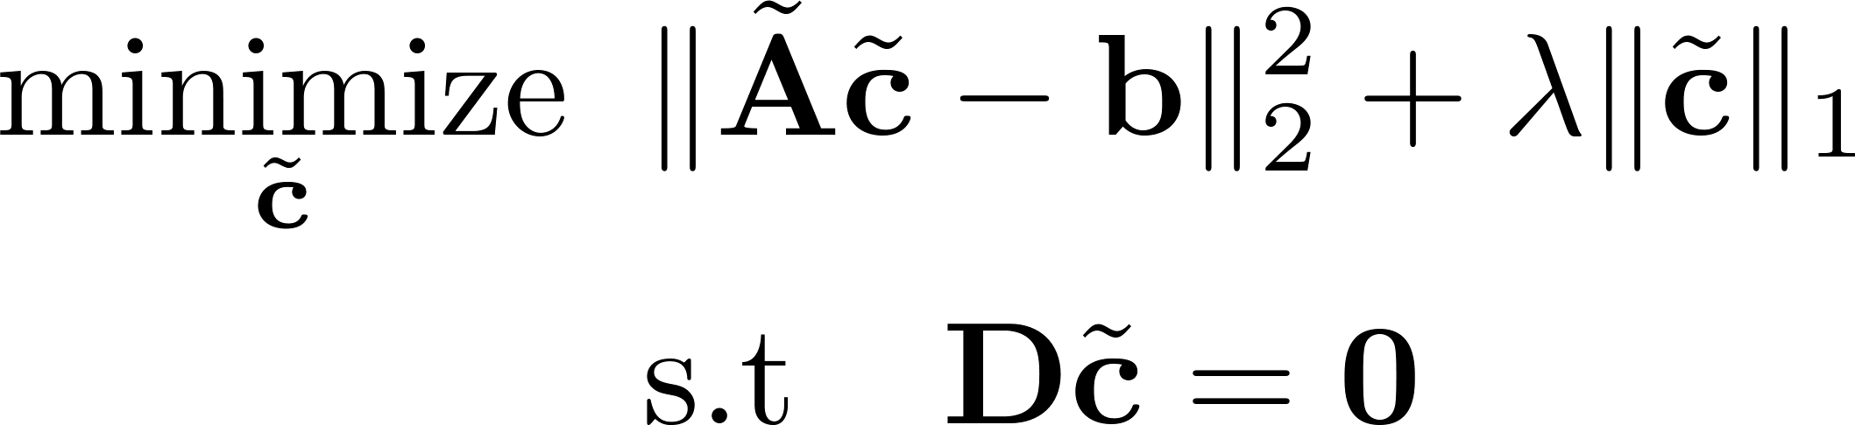
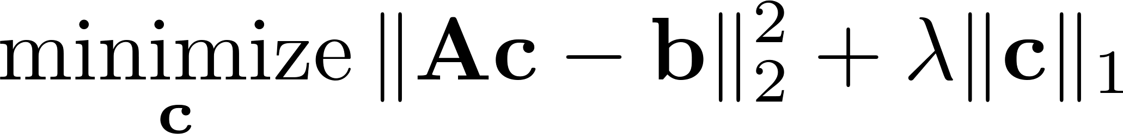
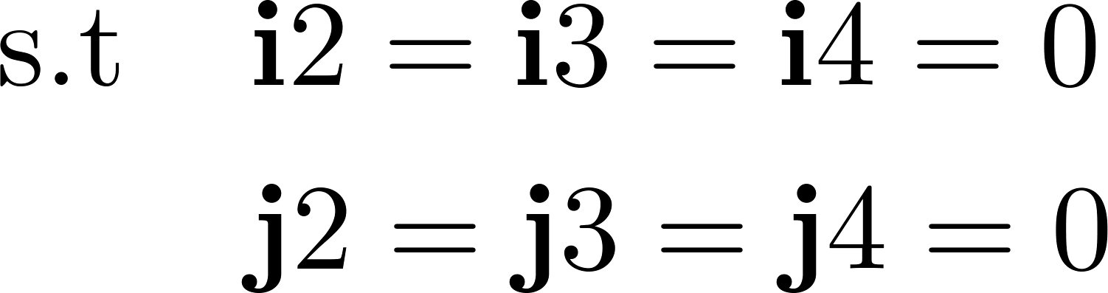
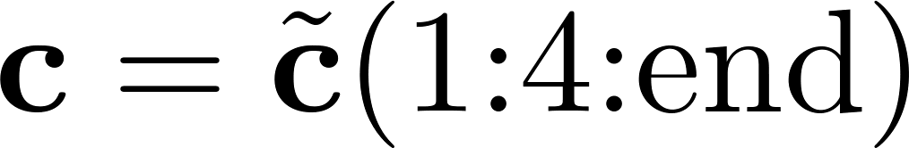
Problem Lifting
Problem lifting
Lifted LASSO
LASSO
i
1
5
i
i2
j
x
2
1
4
3
2
5
8
7
6
i3
2
6
k
y
i4
x
2
2
1
3
6
5
8
7
l
4
y
3
7
.
z
j
z
2
4
6
5
8
m
f
3
2
1
7
j2
4
8
.
j3
f
2
4
3
2
1
8
7
6
5
.
j4
Problem down-sampling
Notes:
To make sure both problems are in fact equivalent, extra constraints are added to force the co-officiants in the new sparse code c tilde corresponding to the new appended columns are zero which can be grouped into the constraints Dc = 0.

Slide 13
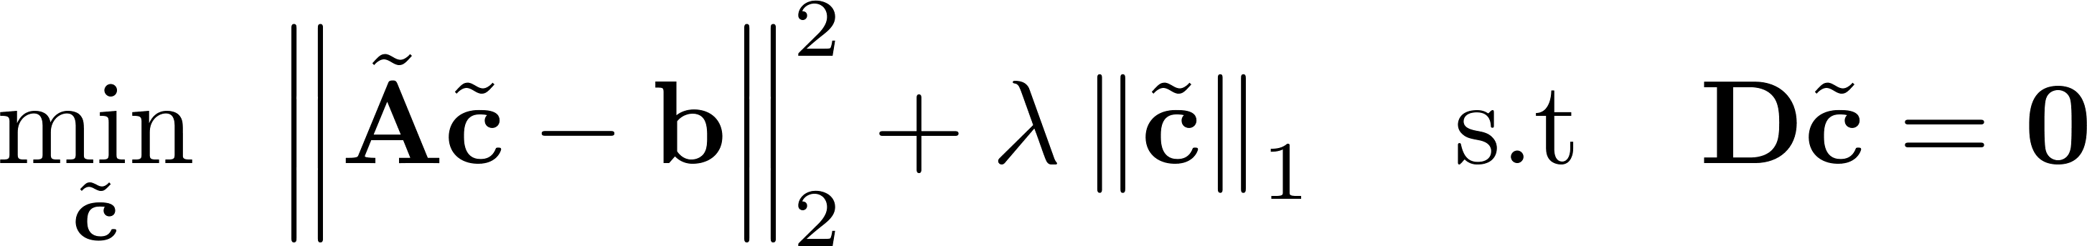
Lifted Problem as Constrained CSC
Notes:
For those of you who work in dictionary learning, the lifted problem is a special version of the convolutional sparse coding where the sparse codes are not arbitrary but constrained to being impulse functions.

Slide 14

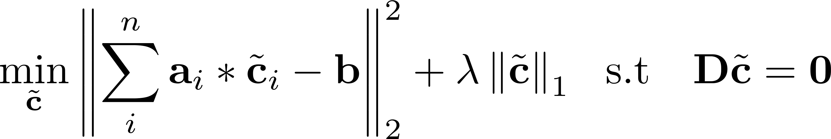
Lifted Problem as Constrained CSC
Notes:
For those of you who work in dictionary learning, the lifted problem is a special version of the convolutional sparse coding where the sparse codes are not arbitrary but constrained to being impulse functions.

Slide 15

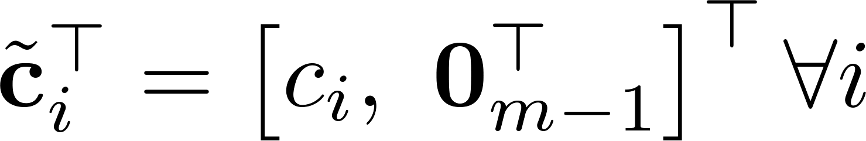
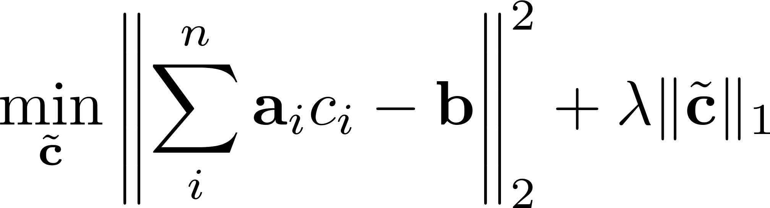
Lifted Problem as Constrained CSC
Since then
Notes:
For those of you who work in dictionary learning, the lifted problem is a special version of the convolutional sparse coding where the sparse codes are not arbitrary but constrained to being impulse functions.

Slide 16
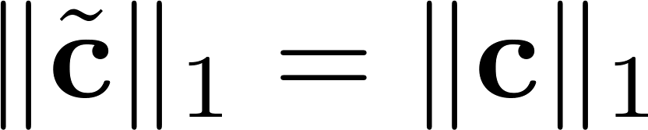
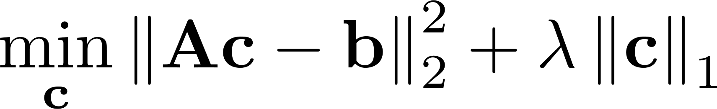
Lifted Problem as Constrained CSC
Since then
Since
Notes:
For those of you who work in dictionary learning, the lifted problem is a special version of the convolutional sparse coding where the sparse codes are not arbitrary but constrained to being impulse functions.

Slide 17
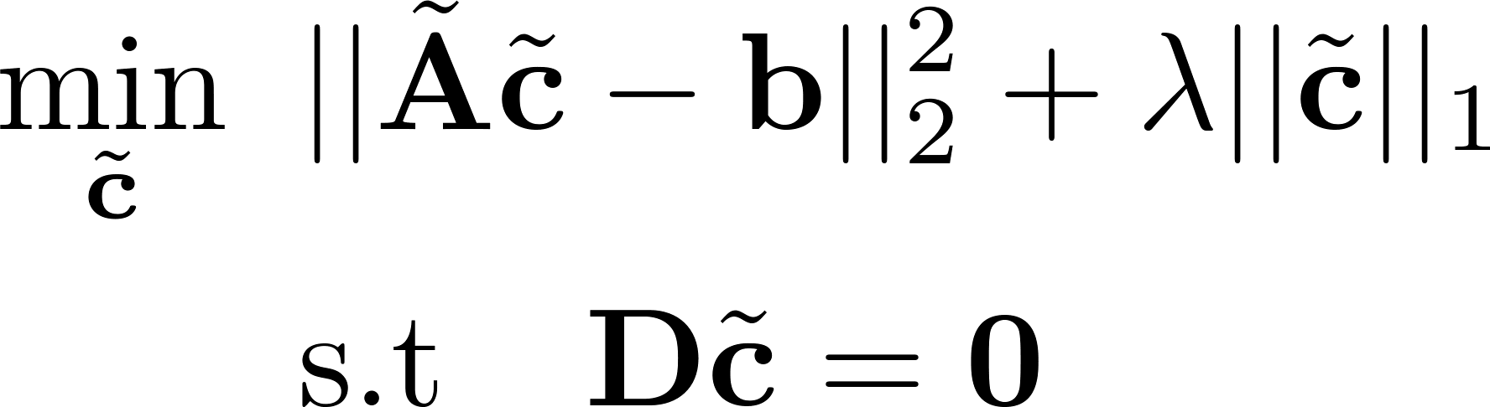
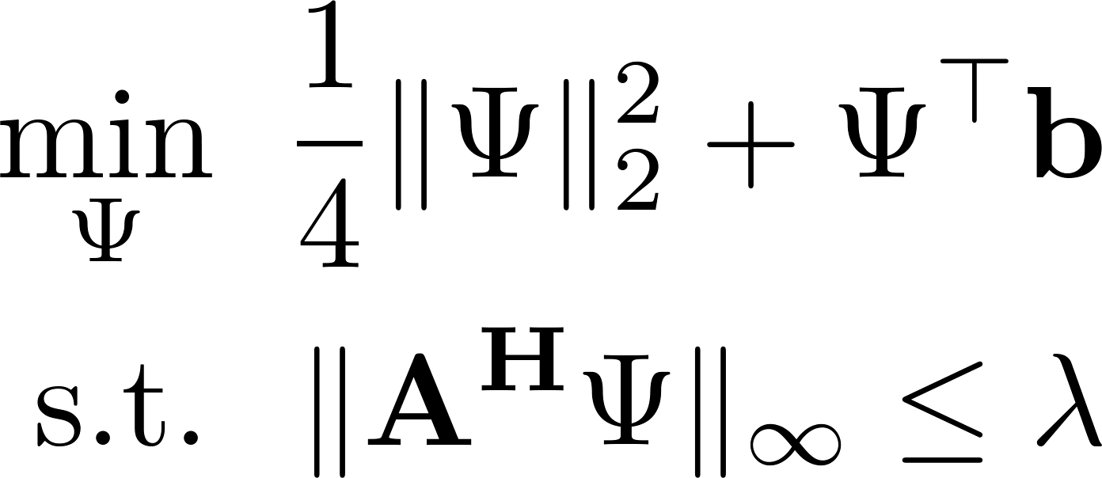
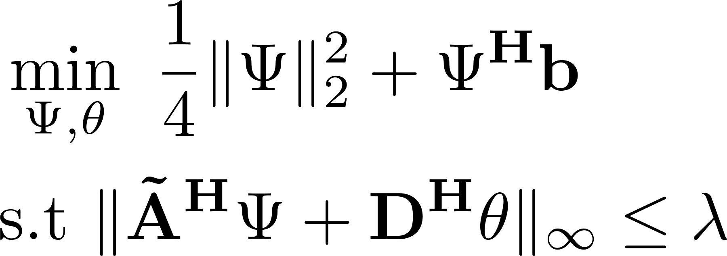
The Big Picture
Problem lifting
DL-ADMM
FFTLasso
1
Notes:
So this is the big picture. On your left is the primal and dual versions of the lasso. Where PL-ADMM and DL-ADMM is applying ADMM to each, respectively. On your left is the lifted lasso and right beneath is its dual forum. FFTLasso is essentially applying ADMM to the dual version of the liften problem to similar reasons o why DL-ADMM is faster than PL-ADMM discussed earlier.

Slide 18
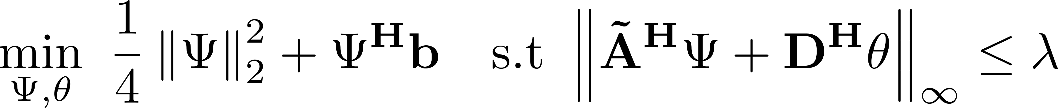
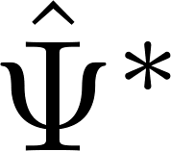
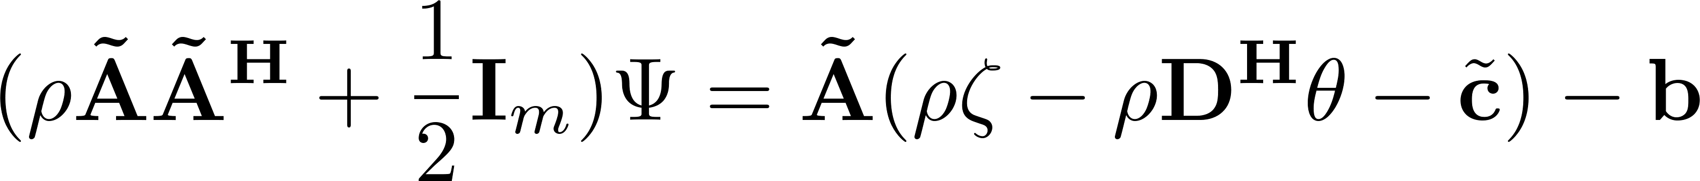
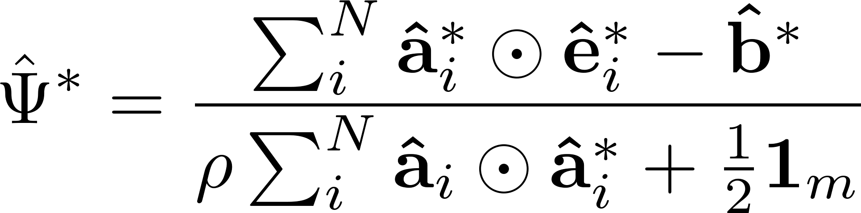
FFTLasso
FFTLasso
Update :
where
Notes:
Alright, now to solve this problem using ADMM, here is give the augmented lagrangian.
So as for the dual variable Psi update, and just like before we need to solve a linear system involving AA^H of size mxm.
However, we do know exactly know how to efficiently solve that linear system using Fourier transforms and ONLY element wise operations and the solution is given as follows. All variables with a hat are the Fourier transforms of the corresponding variables. Also note that the ffts of A are computed only once at the beginning, and therefore we only need to compute the fft of e in each iteration.
All the operations including the division here are elementwise operations.

Slide 19
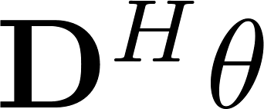
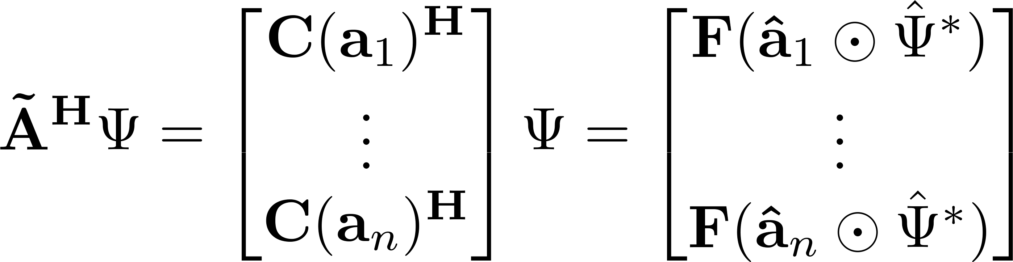

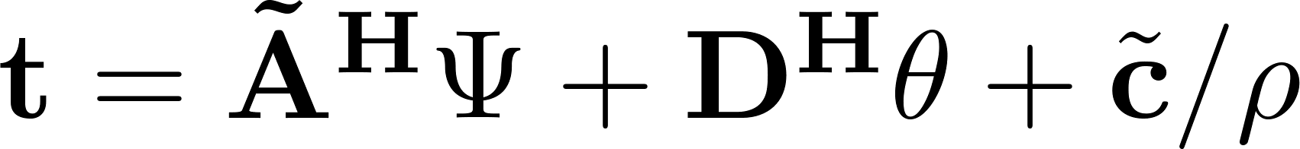
FFTLasso
FFTLasso
Update :
Update :
where
Update :
where
Notes:
Alright, now to solve this problem using ADMM, here is give the augmented lagrangian.
So as for the dual variable Psi update, and just like before we need to solve a linear system involving AA^H of size mxm.
However, we do know exactly know how to efficiently solve that linear system using Fourier transforms and ONLY element wise operations and the solution is given as follows. All variables with a hat are the Fourier transforms of the corresponding variables. Also note that the ffts of A are computed only once at the beginning, and therefore we only need to compute the fft of e in each iteration.
All the operations including the division here are elementwise operations.

Slide 20
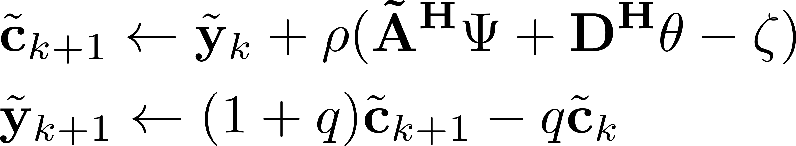
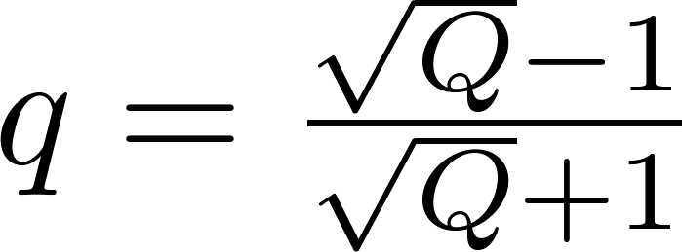
FFTLasso
FFTLasso
Update :
Nesterov’s
Update step:
where
Q is the problem’s condition
number which is set as a hyper parameter
Notes:
And for completion, this is the update for zeta. Again all the operations here are element wise.

Slide 21
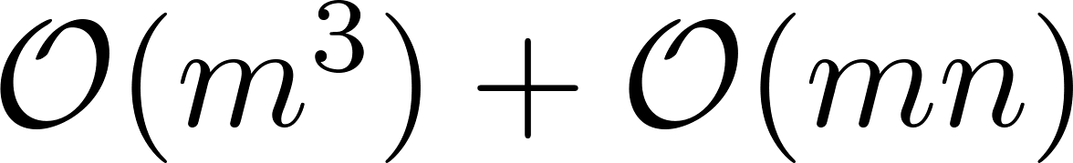
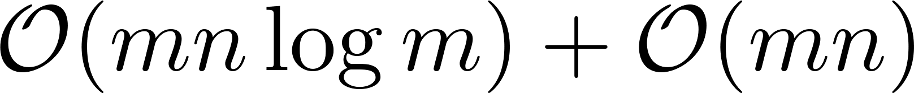
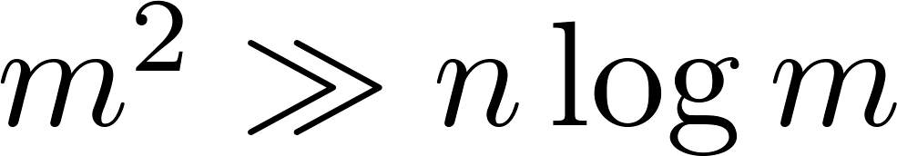
Computational Analysis
v.
DL-ADMM complexity
FFTLasso’s complexity
Dictionaries with are best suited for FFTLasso, where square matrices naturally satisfy the inequality
Notes:
So to give you an idea why did we do all this extra hassle, you can see the speed iteration cost comparison between DL-ADMM and FFTLasso. In FFTLasso, the most expensive operation is taking FFTs of m dimensional vector that is m log m, however we have n of them > so the overall complexity is mn log m. As opposed to DL-ADMM where a linear system solving routine is required, raising the complexity to at most m^3.
This indicates that FFTLasso is best suited for when m^2 is >> than nlog m. This is the case for dictionaries that are large in scale in both dimensions but not having significantly more columns than rows.
This is a plot for a speed comparison where the x y axis are the number of rows m and the ratio n/m. It is clear that comparing the iteration time for FFTLasso is much lower than DL-ADMM even for cases where there are 2.5x more columns than rows.

Slide 22
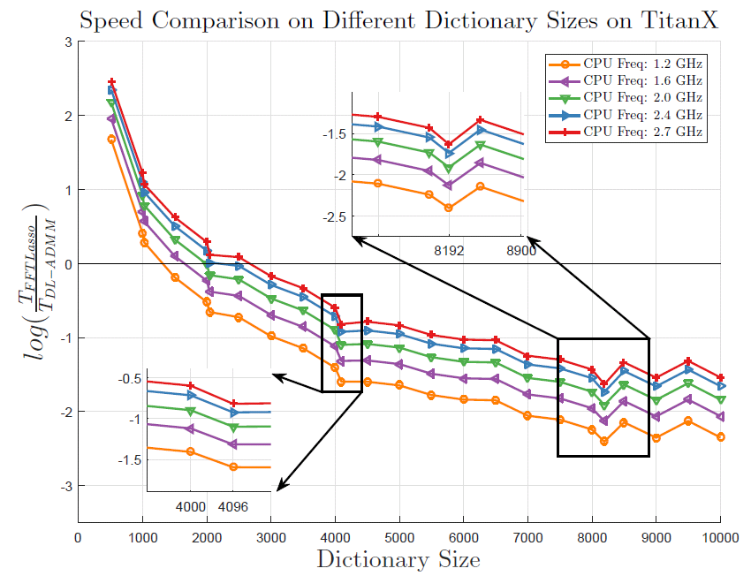
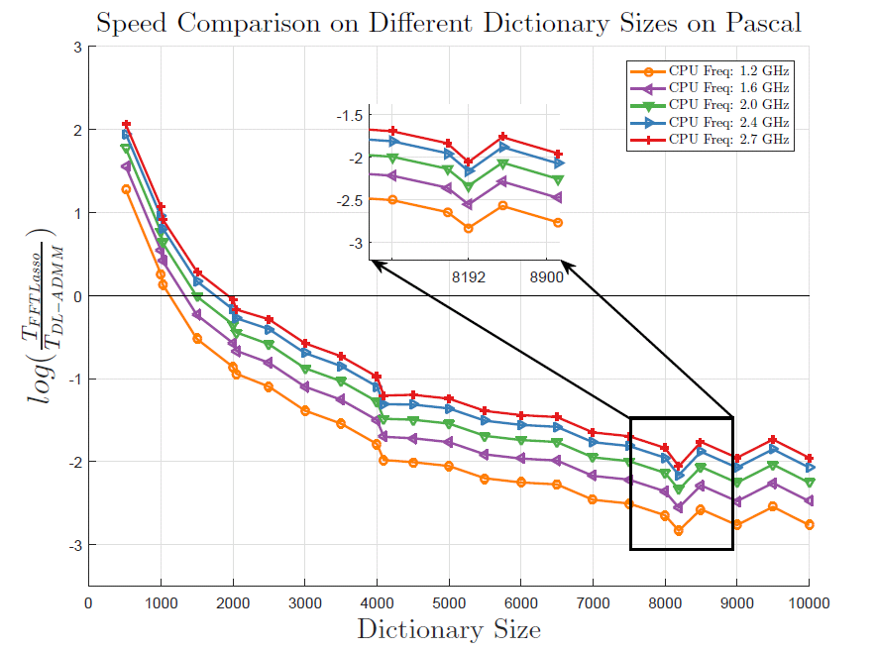
Synthetic Experiments
Comparing DL-ADMM on multi-cores with varying frequency against FFTLasso-GPU
Notes:
So here finally, I present to you some of the results we managed to achieve.
First we compare FFTLasso on a two GPUs (TitanX and Pascal) against a multi core CPU version of DL-ADMM. Despite that CPU cores are much faster than GPU cores sometimes 3 folds, and that there are many powerful linear solver libraries, FFTLasso still outperforms DL-ADMM. Obviously FFTLasso is slower than DL-ADMM for smaller dictionaries but the gap closes as the dimension increases.
A cool note is that you can see dips appearing from time to time. These dips actually occur at dimensions that are power of 2. This is because most of FFTs are best suited for power of 2. If the dimension was to be a something like 2^v + 1, all vectors under the hood will be padded with zeros and x^(v+1) FFTs are computed reducing the performance significantly.
So this shows that actually choosing the right dimensions is significantly important. We still have some room since we can use other radices than 2 to compute the FFTs.

Slide 23
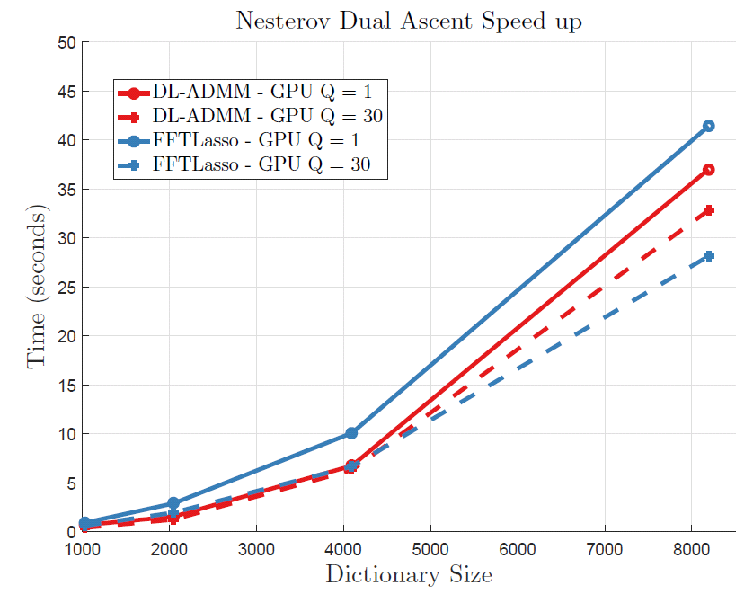
Synthetic Experiments
Pascal Titan X:
Notes:
Another experiment on synthetic data is where we compare both methods on a GPU where we apply the nesterovs trick to both methods as well.
This is performed on powers of 2 as well.
As noticed actually using nesterov’s like update on a convex problem significently improves the performance .. And FFTLasso is still faster than a GPU version of DL-ADMM.
Just to note here when Q = 1 that is the standard dual ascent is used.

Slide 24
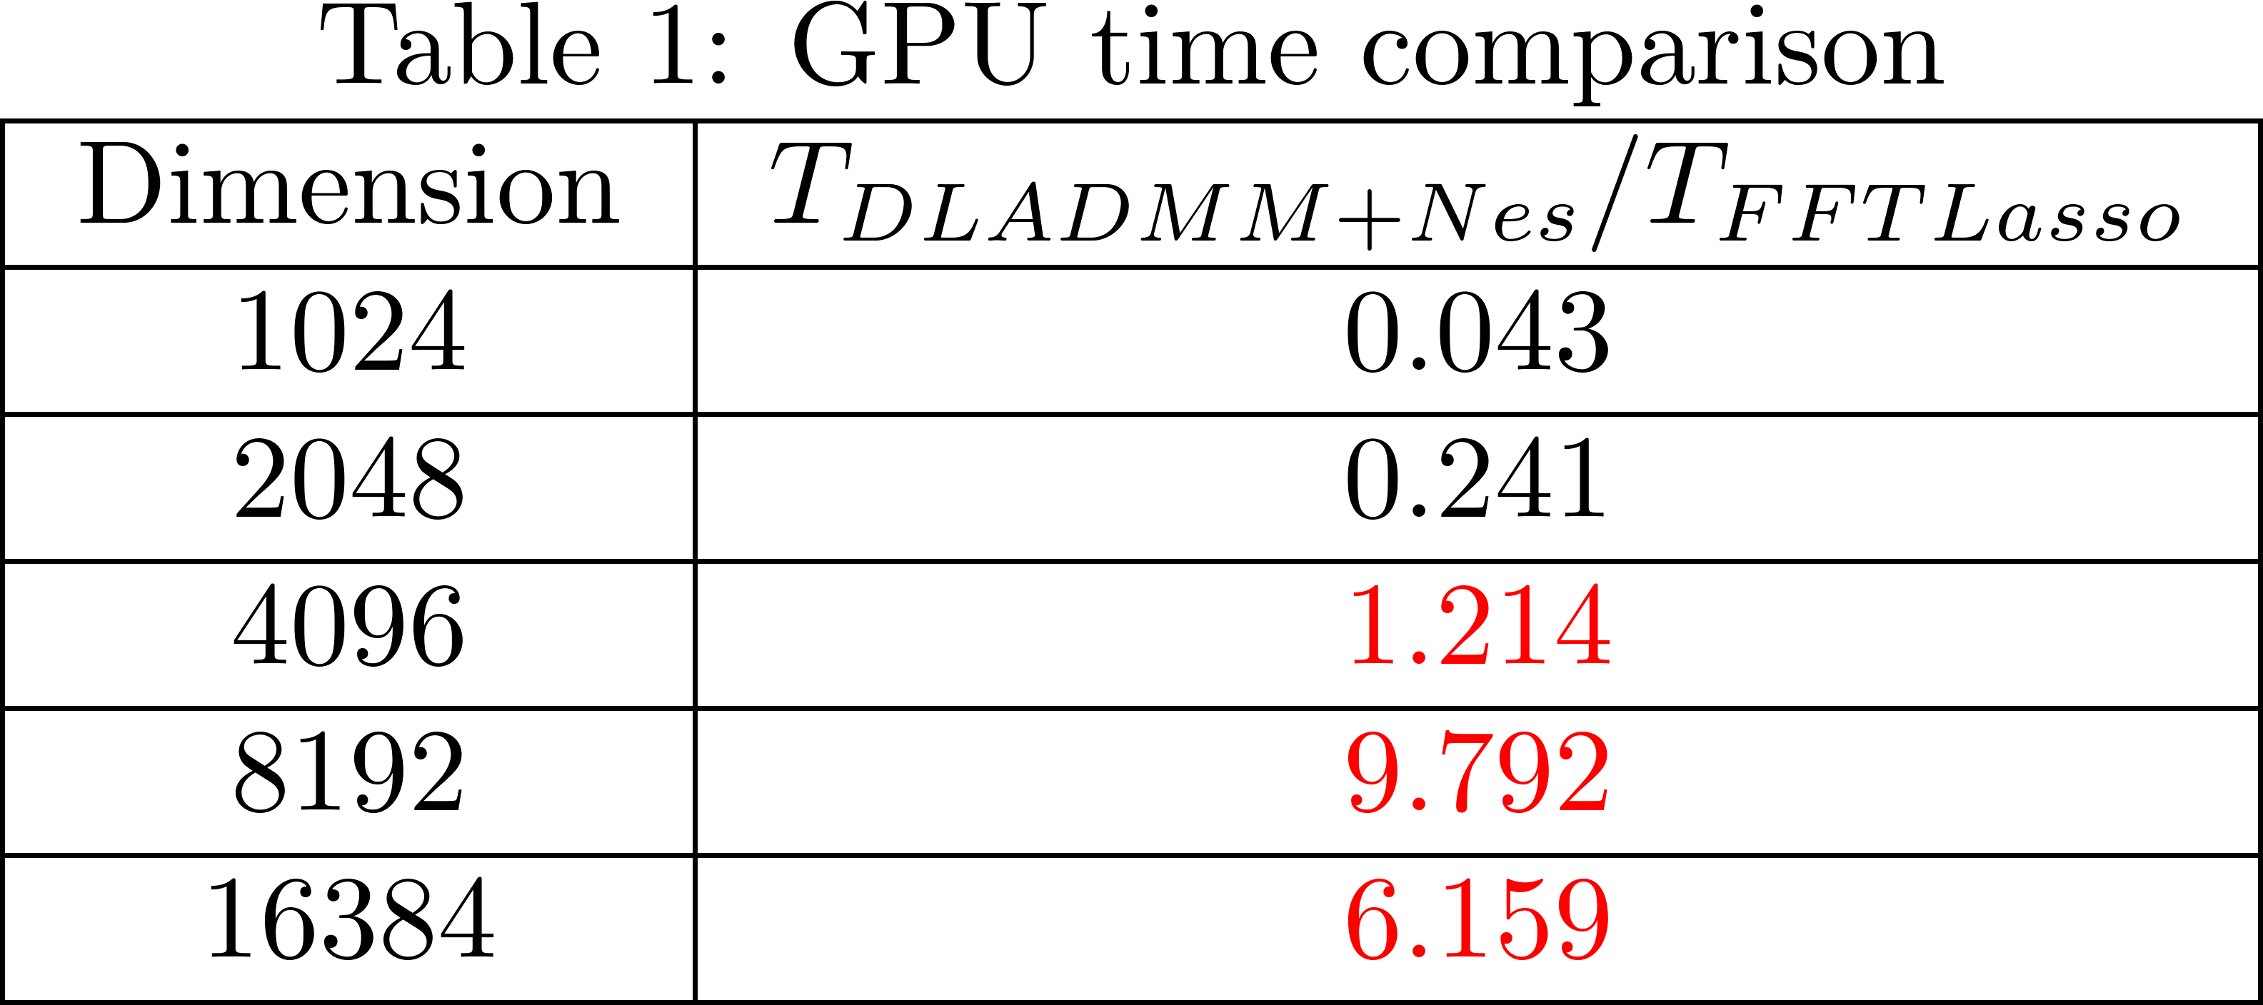
Synthetic Experiments
Quadro P6000:
Notes:
Another experiment on synthetic data is where we compare both methods on a GPU where we apply the nesterovs trick to both methods as well.
This is performed on powers of 2 as well.
As noticed actually using nesterov’s like update on a convex problem significently improves the performance .. And FFTLasso is still faster than a GPU version of DL-ADMM.
Just to note here when Q = 1 that is the standard dual ascent is used.

Slide 25
GPU Distributed FFTLasso
What if the dictionary is so large that it
cannot fit in one GPU?
Notes:
Alright, so since I mentioned that all operations involved are element wise operations, we ask ourselves, is there a chance to make this distributed over multiple GPUs?
The answer is yes with some few measures to take care of.
So, say we have this bulk piece of dictionary A. A is so large that no single GPU can handle (i.g. 100Kx100K). How can FFTLasso benefit form a distributed fashion?

Slide 26
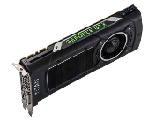
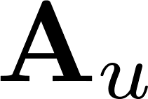

GPU Distributed FFTLasso
What if the dictionary is so large that it
cannot fit in one GPU?
Easy! Break the dictionary into arbitrary number
of vertical pieces. Put each piece on a GPU!
* The necessary overhead is ; where u is the
number of GPUs (for every vertical split).
Notes:
Alright, so option number 1 is that we simply break that matrix vertically and throw each piece on a GPU. In this manner, at each iteration we require to transfer a vector of size m from each gpu, where m is the number of rows.
At one step of the algorithm we need to send over all these small pieces of size m, sum them together and then send the result back to all GPUs.

Slide 27
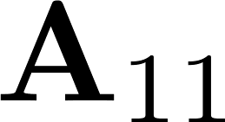
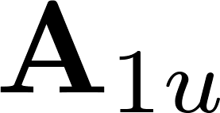
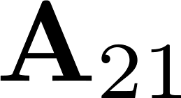
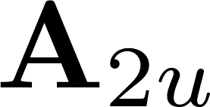
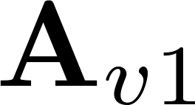
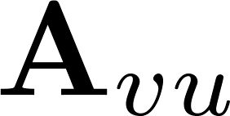
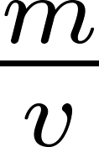
GPU Distributed FFTLasso
Can we do better?
Yes! Break it into horizontal pieces too.
Break them into (even and odd pieces) to
make best use of FFT properties
* The necessary overhead is
Notes:
That sounds nice. But can we do better? Yes, with some details we need to take care of.
We can actually split the dictionary horizontally. However to perform this optimally, one requires to split the matrix A into even and odd pieces on each GPU. This means we first need to break it into two pieces where one piece takes the even indices and the other takes the odd indices.
Then a similar strategy is performed repeatedly on each of these two slits.
With this sort of split strategy, we can relate the FFT of each of the smaller pieces to the FFT of the bigger piece through the equation in yellow. Simply, we take the FFT of each of the smaller pieces, multiply the pieces that are coming from an odd partition by complex exponentials, send them over replicate and sum. SO the overhead is now m/v from each GPU.
With this trick we can now, split the data into arbitrary number of horizontal and vertical splits and tackle larger dictionaries.

Slide 28
Face Recognition
different people
Notes:
As for applications and where large scaleness come into play. Let’s examine the classical face recognition as an application.
As for face recognition for instance, the dictionary matrix A is composed here of several blocks. Each block represents a concatenation of say vectorized image patches of a given person in different say lightening conditions.
So if we have c blocks, we have c different people to recognize among. So, given a new test sample b that we require to determine to what person it belongs to, we look at the solution c and check where most of its coefficients are condensed.
So you can see now where large scaleness come into play. As for the columns, the more sets of categories of people we wish to classify the more columns we have. As for the number of rows, well it is a vectorized image which is self-explanatory. Either way, the dictionary A is large in at least one of the two dimensions.

Slide 29
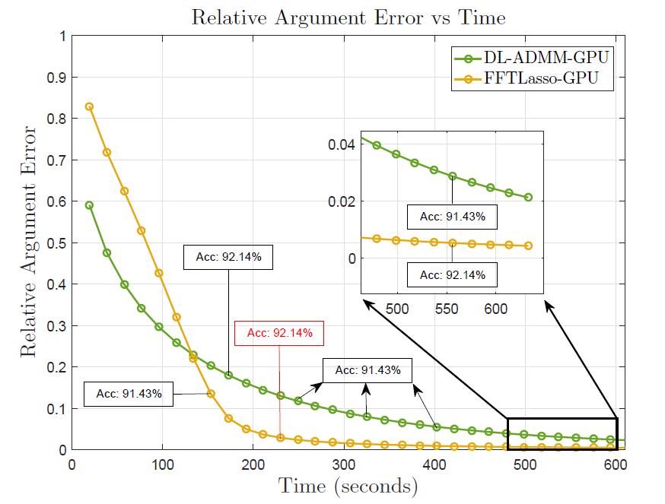



Face Recognition Experiments
Notes:
Lastly, we conduct our experiments on face recognition (Yale base [B]) dataset.
In both experiments, there were 10K images were each image has a total of 2^12 pixels (on your left) and 2^13 pixels (on your right).
This is much bigger than the commonly used 1000,2000 pixels as dimensions. As can be seen that the recognition accuracy with 2^13 pixels on your right is about 97% compared to 92% for 2^12 pixels just because we have increased the dimensionality demonstrating the importantce of going to large scale in some vision applications.
For this experiment, we compare FFTLasso and DL-ADMMM by giving both solvers the same exact amount of time and we compare the quality of the final solution to some high accuracy precomputed solution.
FFTLasso converges to a much better solution than DL-ADMM for a fixed amount of time with very good recognition accuracy rate.

Slide 30
Future Directions
FFTLasso is easily distributed and also memory efficient (something to talk about at the poster ☺ )
FFTLasso can handle linearly constrained problems (constrained lasso?)
Other non-smooth regularizers may be used?
Notes:
To sum up, FFTLasso is best suited for applications that have dictionaries large in both dimensions >10K. We have examined that FFTLasso can also handles constraints without any added complexity over DL-ADMM since it performs ADMM. Since FFTLasso is concerned mostly about the fitting term, other non-smooth regularizers may be examined. If the dictionary was too large to be handled at once, distributed FFTLasso makes it possible.

Slide 31







Code and Special Thanks!
Come see us
at Poster:
#10
Congli Wang
Humam Alwassel
Modar Alfadly
https://github.com/adelbibi/FFTLasso
Notes:
We have versions of FFTLasso on Cuda. Great thanks and shout out to Congli Wang for his help in the development. We have a MATLAB, numpy and tesnorflow version of it too.
As for the distributed version, great thanks to Humam and Modar for their distrusted FFTLasso tensorflow development.

Slide 32
Thank You!
Notes:
Thank you for your attention.

Slide 33




Applications
Face Recognition
Visual Object Tracking
Super Resolution
Subspace Clustering
Notes:
LASSOs found their way to many classical computer vision applications. For instance, it has been used for face recognition and tracking. Discussions of these I’ll leave for later when we talk about where large scaleness jump into play.
It has a great role in some super resolution frameworks where a smaller patch (block) is represented as a sparse linear combination of other smaller patches of high resolution images.
Sparse Subspace clustering also uses a lasso framework to cluster data points and uncover their corresponding subspace dimensionality simultaneously where it has been used for motion segmentation.

Slide 34

Large Scale?
Visual Object Tracking
Particle sample
Vectorized image patches of
previous frames
Notes:
The other application here is visual object tracking. To save us some time the same idea applies; however, the columns in the dictionary are previous examples to how the object looked like. Then the lasso is solved for each possible candidate (b) in the new frame. Making the dictionary as diverse and large as possible is necessary to capture all different appareance variations of the object resulting in a large scale problem.

Slide 35
Solving the LASSO
Lasso Solvers
Deterministic Solvers
First Order Methods
Second Order Methods
Randomized Solvers
Notes:
Alright enough with the applications and let’s job into some solvers.
LASSO solvers can in general be divided into randomized methods and deterministic methods. Randomized methods have demonstrated a great potential to solve linear systems very efficiently lately. However, this talk will be focused on deterministic solvers.
In general, there are zero first and second order methods. First order methods enjoy inexpensive iteration cost with at most linear convergence rates. Proximal point methods and ADMMs are good examples.
Second order methods on the other hand require to have access to the hessian or at least a proxy version of it increasing their iteration computational complexity significantly. They however enjoy quadratic rates. Proximal dual interior point methods are an example.

Slide 36
ISTA, FISTA and ADMMs
ISTA (sublinear rate)
Proximal gradient
FISTA
Nesterov’s like update scheme
Notes:
First order solvers can in general be divided to proximal gradient with ISTA and FISTA as examples. They differ mainly in how the final solution is combined as FISTA uses a nesterov’s like update scheme to accelerate ISTA.

Slide 37
Solving the LASSO
The Focus of this work is on Deterministic First Order Methods
Pros: Inexpensive iteration cost
Cons: Lower convergence rate
Examples
(1) Proximal point methods
(2) ADMMs
Lasso Solvers
Deterministic Solvers
Second Order Methods
Randomized Solvers
First Order Methods
First Order Methods
Pros: Quadratic rates
Cons: Expensive Iteration cost
Examples
Primal dual interior point methods
Notes:
However, the focus of this talk will be on deterministic first order methods.

Slide 38
ISTA, FISTA and ADMMs
Primal Lasso (PL-ADMM)
ISTA (sublinear rate)
Solving a PD linear system of size nxn
Proximal gradient
ADMMs
FISTA
Dual Lasso (DL-ADMM)
Nesterov’s like update scheme
Solving a PD linear system of size mxm
Notes:
Another approach is to use ADMM on either the Lasso directly given here as PL-ADMM. Or to lasso’s dual problem called here DL-ADMM.
The bottleneck really in either method boils down to solving linear systems. However, in general for primal lassos we need to solve a linear system of size nxn where for dual lasso it is of size mxm where A is of size mxn. Well, given that in the lasso often has a fat dictionary A (more columns than rows) the obvious answer DL-ADMM is significantly less expensive.

Slide 39
The Big Picture
PL-ADMM
Primal
DL-ADMM
FFTLasso
Dual
Notes:
So this is the big picture. On your left is the primal and dual versions of the lasso. Where PL-ADMM and DL-ADMM is applying ADMM to each, respectively. On your left is the lifted lasso and right beneath is its dual forum. FFTLasso is essentially applying ADMM to the dual version of the liften problem to similar reasons o why DL-ADMM is faster than PL-ADMM discussed earlier.

Slide 40



Majorization Minimization Frameworks
Successively minimize a surrogate upper bound
Lipschitz constant related (maximum eigenvalue of )
Notes:
Most of the deterministic first order solvers are a natural derivative of the majorization minimization framework.
The idea is very simple, all we need to solve instead of the original problem is a surrogate upper bound in every iteration. That guarantess the problem to converge to a local minima, and if the problem is convex like the lasso; well problem solved.
A natural upper bound on smooth functions (particularly L smooth functions) is a quadratic function with respect to some constant L. So now we replace the smooth part f© with its surrogate counterpart s(c,c^k) where c^k is a previous estimate of the solution.
L should be large enough, in particular it should be at least as big as the maximum eigenvalues of ATA. Of course we can perform exact line search to find L.

Slide 41



ADMM (PL-ADMM, DL-ADMM)
Solving a PD linear system of size nxn
Solving a PD linear system of size mxm
Notes:
Another approach is to use ADMM on either the primal or dual version of the LASSO.
The algorithm lists to the update rules for all the variables of the ADMM framework if we would apply it directly to the lasso. That we will call PL-ADMM for Primal lasso.
As you can see in red, the most expensive operation is solving a PD linear system involving ATA. If A is of size mxn, then the system is of size nxn.
Another approach is to apply ADMM to the dual equivalent of LASSO given on yor bottom right. This will require on the other hand solving a PD linear system of size mxm instead.
Which is better, will given that in the lasso problem has often a fat dictionary A (has more columns than rows) the obvious answer is DL-ADMM.

Slide 42





Introducing FFTLasso
Circulant matrices can be used to carry out
convolutions and correlations
Correlation:
Convolution:
The most expensive operation is computing the FFTs which
can be done in .
Notes:
Before we start introducing FFTLasso, let’s first introduce some basic concepts.
To those of you who are not familiar with circulant matrices, a circulant matrix can always be fully characterized by only its first row/column where the rest of the elements are simply a circular shifts of it as seen here.
The figure on the right is a simply an example of a 3x3 circulant matrix.
Why is it important? Because a circulant matrix multiplied by a vector represents a discrete circular correlation between that vector and the first row. And if that matrix was to be hermetianed (complex conjugate and transpose), the resulting operation is a discrete circular convolution.
Great so what? Well, all circulant matrices can be efficiently diagonalized where the eigenvalues are simply the Fourier transform of the first row of the circulant matrix and the eigenvectors are the columns of the normalized DFT matrix (discrete Fourier transform) (it’s fixed and known) denoted in F.
So how expensive is it to apply eigen decomposition to a circular matrix; well it is as fast as we can compute fourier transforms, and thanks to FFTs we can do it in O(n log n) where n is the length of the vector.

Slide 43
Solving the LASSO
Pros: Inexpensive iteration cost
Cons: Lower convergence rate
Examples
(1) Proximal point methods
(2) ADMMs
Lasso Solvers
Deterministic Solvers
First Order Methods
Second Order Methods
Randomized Solvers
Pros: Quadratic rates
Cons: Expensive Iteration cost
Examples
Primal dual interior point methods
Notes:
As for the solvers, LASSO solvers can in general be divided into randomized methods and deterministic methods. Randomized methods have demonstrated a great potential to solve linear systems very efficiently lately. However, this talk will be focused on deterministic solvers only.
First order deterministic methods enjoy inexpensive iteration cost with at most linear convergence rates. Proximal point methods and ADMMs are good examples.
Second order methods on the other hand require to have access to the hessian or at least a proxy version of it increasing their iteration computational complexity. They however enjoy quadratic rates. Proximal dual interior point methods are an example.

Slide 44

Introducing FFTLasso
Notes:
Great. That’s all we need to know.
FFTLasso’s idea is very simple. On your left is the standard lasso, where we transform it to FFTLasso’s formulation.
We simply look at each column in the original matrix A and explode it into a circular matrix generating an even much bigger dictionary.
So if the original A is of size mxn, the new dictionary A tilde is of size m x (mn). To make sure both problems are in fact equivalent, extra constraints are added forcing the co-officiants in the solution vector c-corresponding to these extra columns to be exactly zero.
So if the problem was originally large, it is now even larger and constrained which is counter intuitive.

Slide 45

FFTLasso
FFTLasso
Update :
where
Notes:
Alright, now to solve this problem using ADMM, here is give the augmented lagrangian.
So as for the dual variable Psi update, and just like before we need to solve a linear system involving AA^H of size mxm.
However, we do know exactly know how to efficiently solve that linear system using Fourier transforms and ONLY element wise operations and the solution is given as follows. All variables with a hat are the Fourier transforms of the corresponding variables. Also note that the ffts of A are computed only once at the beginning, and therefore we only need to compute the fft of e in each iteration.
All the operations including the division here are elementwise operations.

Slide 46
FFTLasso
FFTLasso
Update :
Notes:
Similarly for updating theta. Since theta doesn’t appear alone but always with D^H before it. So and for efficiency we update D^H theta jointly.
D is merely a selection of the elements in the vector D^H theta that correspond to the added columns in A tilde. So basically we are only updating few elements of D^H theta at a time where we know there exact location.

Slide 47
FFTLasso
FFTLasso
Update :
where
Notes:
And for completion, this is the update for zeta. Again all the operations here are element wise.

Slide 48
FFTLasso
FFTLasso
Update :
where
Notes:
And for completion, this is the update for zeta. Again all the operations here are element wise.

Slide 49
FFTLasso
FFTLasso
Update :
Q is the problem’s condition
number which is as a hyper
parameter.
Nesterov’s Update
step:
where
Notes:
Lastly, the dual variables of the dual problem are the primal variables so c tilde here is in fact the sparse codes we are solving for and they are often updated with a standard dual ascent step.
We however in FFTLasso solve the problem with nesterov’s like update to improve the convergence. Q here is related to the problem’s condition number it is in our setup set as a hyper parameter but can be computed using exact line search at the expense of extra computation in each Iteration.

Slide 50

FFTLasso
Notes:
The complete algorithm is given here. Upon convergence, the final solution c can be obtained after final convergence by simply subsampling the solution c tilde. This is equivalent to taking the codes corresponding to the original columns in A.

Slide 51

Computational Analysis
FFTLassoss’ complexity
DL-ADMM complexity
Dictionaries with are best
suited for FFTLasso, where square matrices
naturally satisfy the inequality.
Notes:
So to give you an idea why did we do all this extra hassle, you can see the speed iteration cost comparison between DL-ADMM and FFTLasso. In FFTLasso, the most expensive operation is taking FFTs of m dimensional vector that is m log m, however we have n of them > so the overall complexity is mn log m. As opposed to DL-ADMM where a linear system solving routine is required, raising the complexity to at most m^3.
This indicates that FFTLasso is best suited for when m^2 is >> than nlog m. This is the case for dictionaries that are large in scale in both dimensions but not having significantly more columns than rows.
This is a plot for a speed comparison where the x y axis are the number of rows m and the ratio n/m. It is clear that comparing the iteration time for FFTLasso is much lower than DL-ADMM even for cases where there are 2.5x more columns than rows.

